Slide 1
异物检测
TransCD 11 大类 30左右个小类
每类4-6视频， 每个视频900-7,000 帧
VL-CMU-CD 总共152 视频，每个视频。
平均每个视频9帧
不同变化检测模型性能对比
 | CD2014 |  | VL-CMU-CD |  | PCD2015 |  |  |  | ChangeSim |  | VL-CMU-CD→PCD |  | PCD→VL-CMU-CD
 |  |  |  |  | Tsunami |  | GSV
 | F-Score | Precision | F-Score | Precision | F-Score | Precision | F-Score | Precision | F-Score | Precision | F-Score | Precision | F-Score | Precision
CosimNet-3layer-l2 | 0.8591 | 0.9383 | 0.706 |  | 0.806 |  | 0.692
TransCD | 0.9361 | 0.9427 | 0.7152 | 0.7768
DSP |  |  | 76.5 | 83.2 | 74.8 |  | 57.9 |  |  |  | 43.1 |  | 27.5
TransCD在CD2014的预训练模型对比
 | Res_SViT_E1_D1_16 | Res_SViT_E4_D4_16 | SViT_E1_D1_16 | SViT_E1_D1_32 | SViT_E4_D4_16 | SViT_E4_D4_32
precision | 0.9377 | 0.938362399 | 0.9359996 | 0.948287 | 0.94037188 | 0.9427951
oa | 0.99747693 | 0.99761755 | 0.99709818 | 0.9976825 | 0.9975471 | 0.997791
recall | 0.911823 | 0.9230575 | 0.889749 | 0.9196107 | 0.9157074 | 0.9297533
f1 | 0.92449 | 0.9304959 | 0.9117871 | 0.9334893 | 0.9277132 | 0.9361062
kappa | 0.9231893 | 0.9292645 | 0.91029 | 0.9322882 | 0.9264455 | 0.9349626

Slide 2
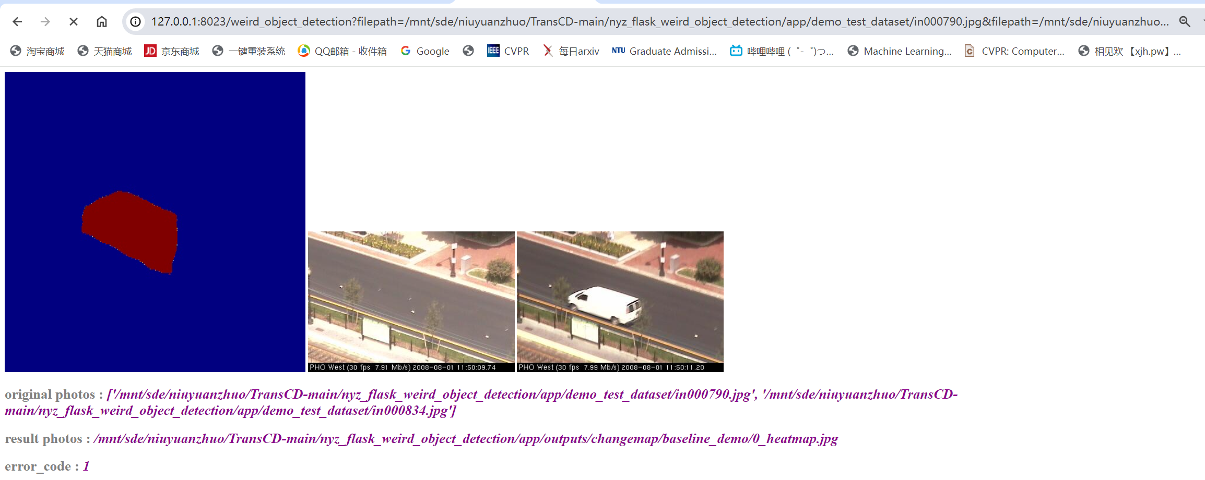
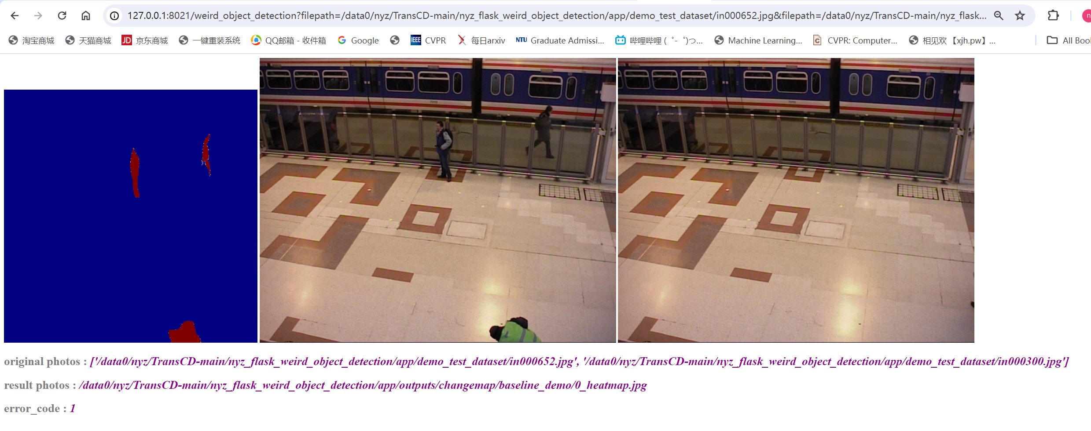
异物检测
TransCD SViT_E1_D1_32

Slide 3
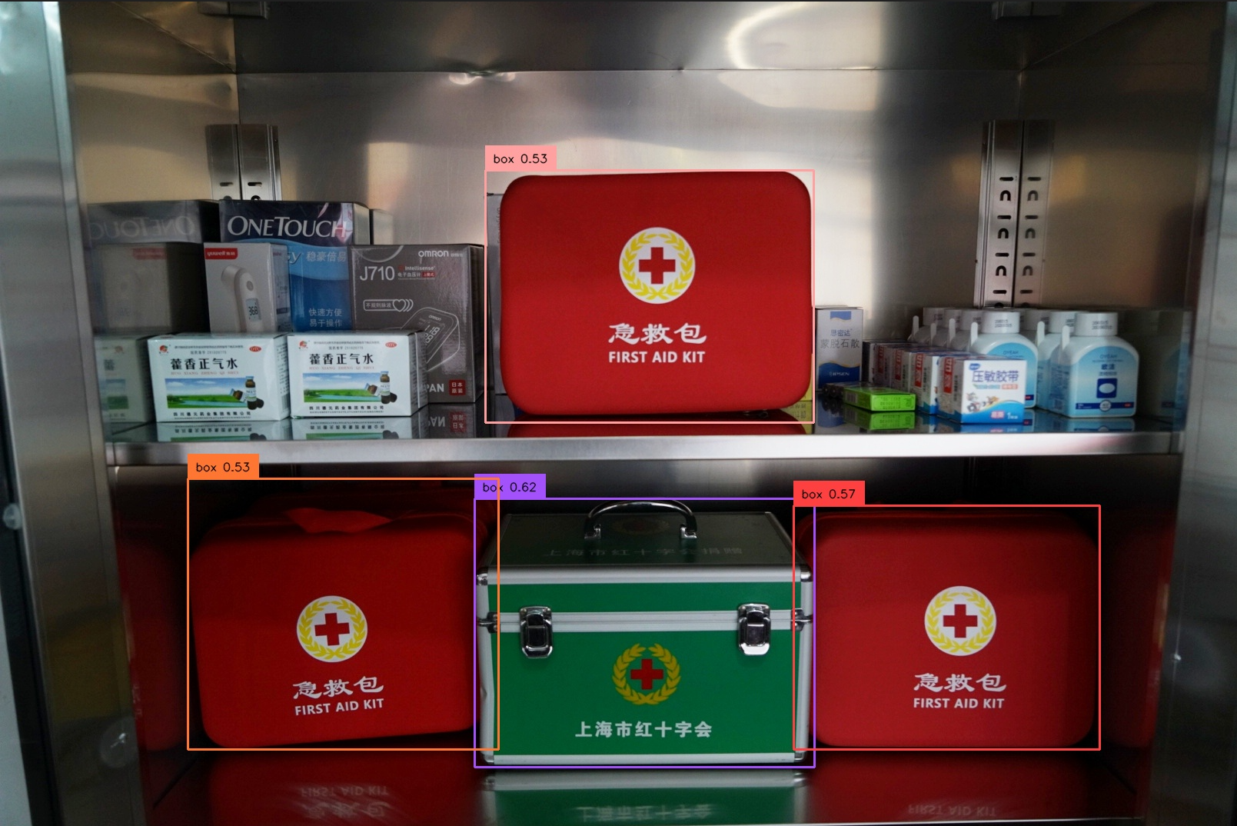


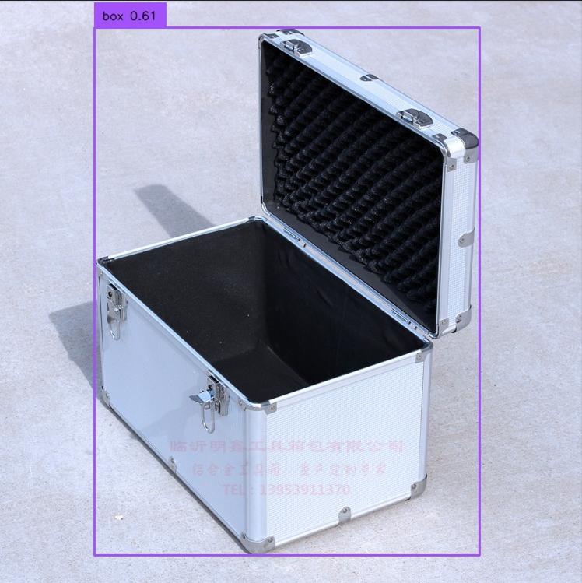

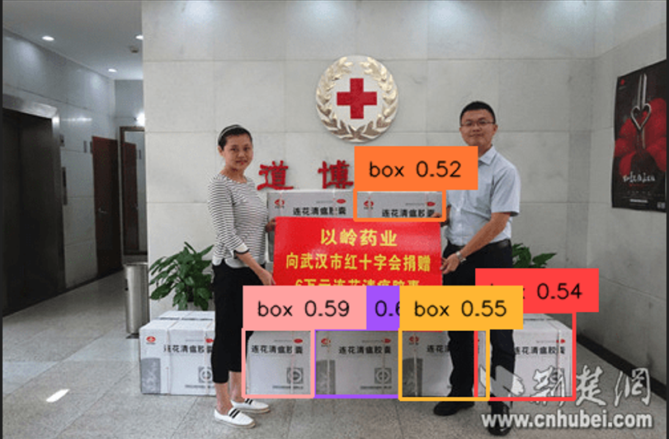
关键设备
Grounding dino

